Slide 1
How to increase tourism in Boston using Data Science
By Taylor J. Simpson

Slide 2

Agenda
-Background
-Tourism Stats
-Business Problem
-Methodology
-EDA
-Recommendations

Slide 3
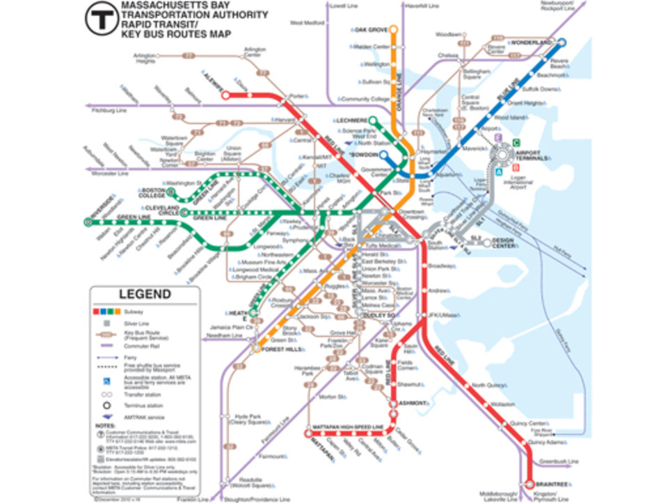
Background
-Founded in 1630
-Current population of ~700,000 proper and ~4.8 million GMA
-52 Colleges in the area
-$363 Billion Economy - 6th in the country 12 in the world
-Best pro sports city in America this century

Slide 4
Tourism Stats
$22.9 Billion
32.9 Million Tourists/Year
149,000 Jobs Supported

Slide 5

Problem

Slide 6
“What’s the last process you went through when planning a vacation?

Slide 7

Methodology
Gathering Data
Python
Webscraping
.JSON
CSV

Slide 8
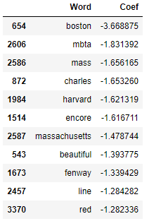
EDA
Logistic Regression
Analysis
 | Actual No | Actual Yes
Predicted No | 172 | 36
Predicted Yes | 42 | 161
80.97%
Accuracy

Slide 9
Recommendations

Slide 10

REDDIT
V Community and Internet culture oriented site
Do an AMA and contest
Run Ads on Reddit
Emphasize neighborhoods, variety of activities and accessibility

Slide 11
Thanks!
Any questions?
You can email me at taylorjsimpson18@gmail.com

